Slide 1

Project: G2M Insight For Cab Investment Firm

Slide 2
Outline
Problem Statement
Datasets Information
Exploratory Data Analysis
Multiple Hypothesis Test
Summary

Slide 3

Problem Statement

Slide 4
Problem Statement
XYZ is a private equity firm in the US. Due to remarkable growth in the Cab Industry in the last few years and multiple key players in the market, it is planning for an investment in the Cab industry.
Objective: Provide actionable insights to help XYZ firm in identifying the right company for making an investment.
The analysis has been divided into four parts:
Data Understanding and Visualization
Finding the most users Cab company
Finding the cheapest Cab company for users
Finding the most profitable Cab company

Slide 5

Data Information

Slide 6
Data Information
Dataset Information:
Cab Data: This dataset contains information about cab rides and includes details like the transaction ID, date of travel, company, city, kilometers traveled, price charged, cost of the trip, and state.
City Data: This dataset contains information about various cities, including their population, number of users, city name, and state.
Customer Data: This dataset contains information about customers, including customer ID, gender, age, and income (USD/month).
Transaction Data: This dataset includes information about transactions, including the transaction ID, customer ID, and payment mode.
Timeframe:
Time period of data is from 31/01/2016 to 31/12/2018.
Total Data Points:
Total number of records in the dataset: 359392
Cab_Data.csv
Customer_ID.csv
Transaction_ID.csv
City.csv
Final cab data

Slide 7
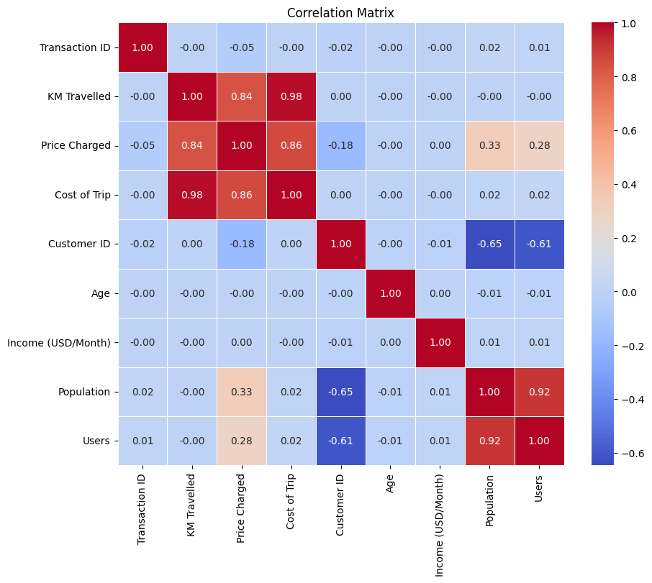
Correlation Between Variables
As we can see there is a strong correlation between
Population vs Users
Price Charged vs Cost of Trip vs KM Travelled

Slide 8
EDA

Slide 9
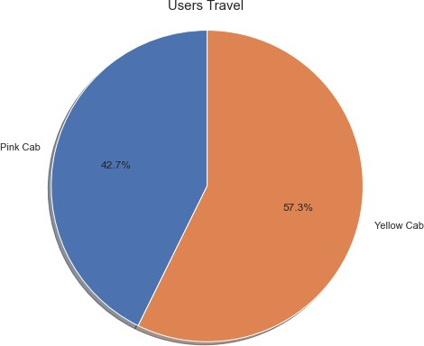
Which Company has more Users?
As we can see users like to ride on Yellow cab more as compared to Pink Cab

Slide 10
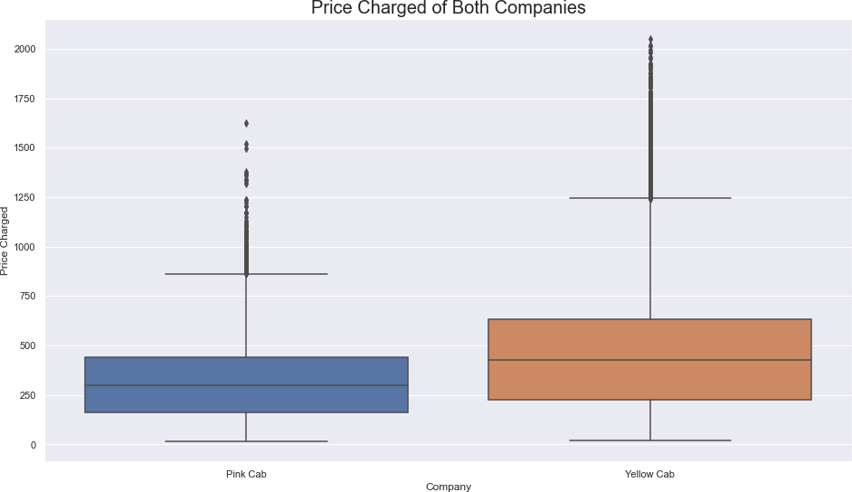
Which Company has a high price charged?
As we can see Price Charged for Yellow Cab is highest as compared to Pink Cab

Slide 11
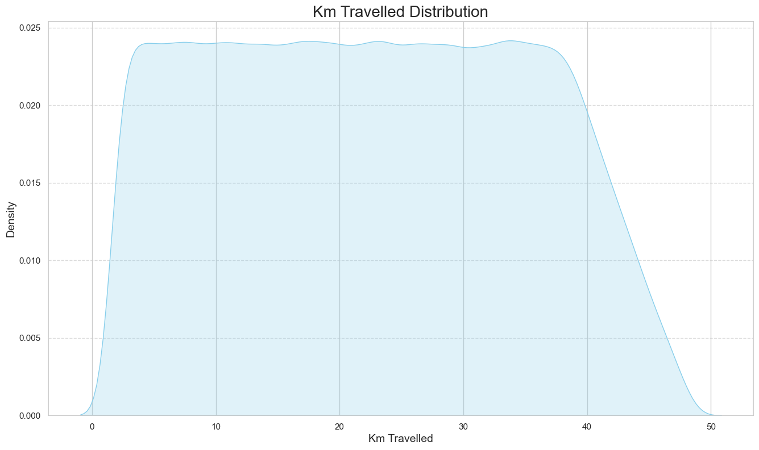
KM Travelled Distribution
Most of the rides varies from 2 to 48 KM.

Slide 12
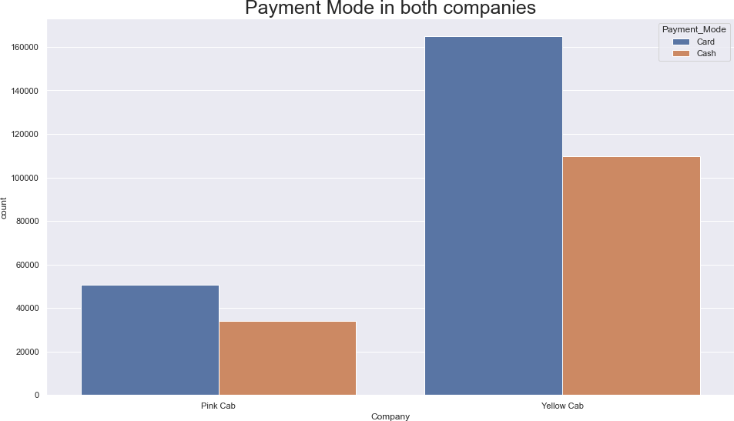
Payment Mode
As we can see that users prefer to pay with a card more compared to cash

Slide 13
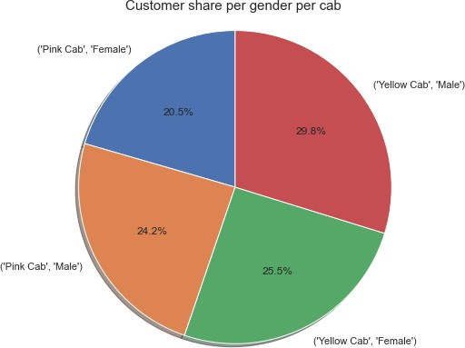
Users w.r.t Gender
Male users prefer more to travel in Cab
Also Users prefer to travel in Yellow Cab

Slide 14
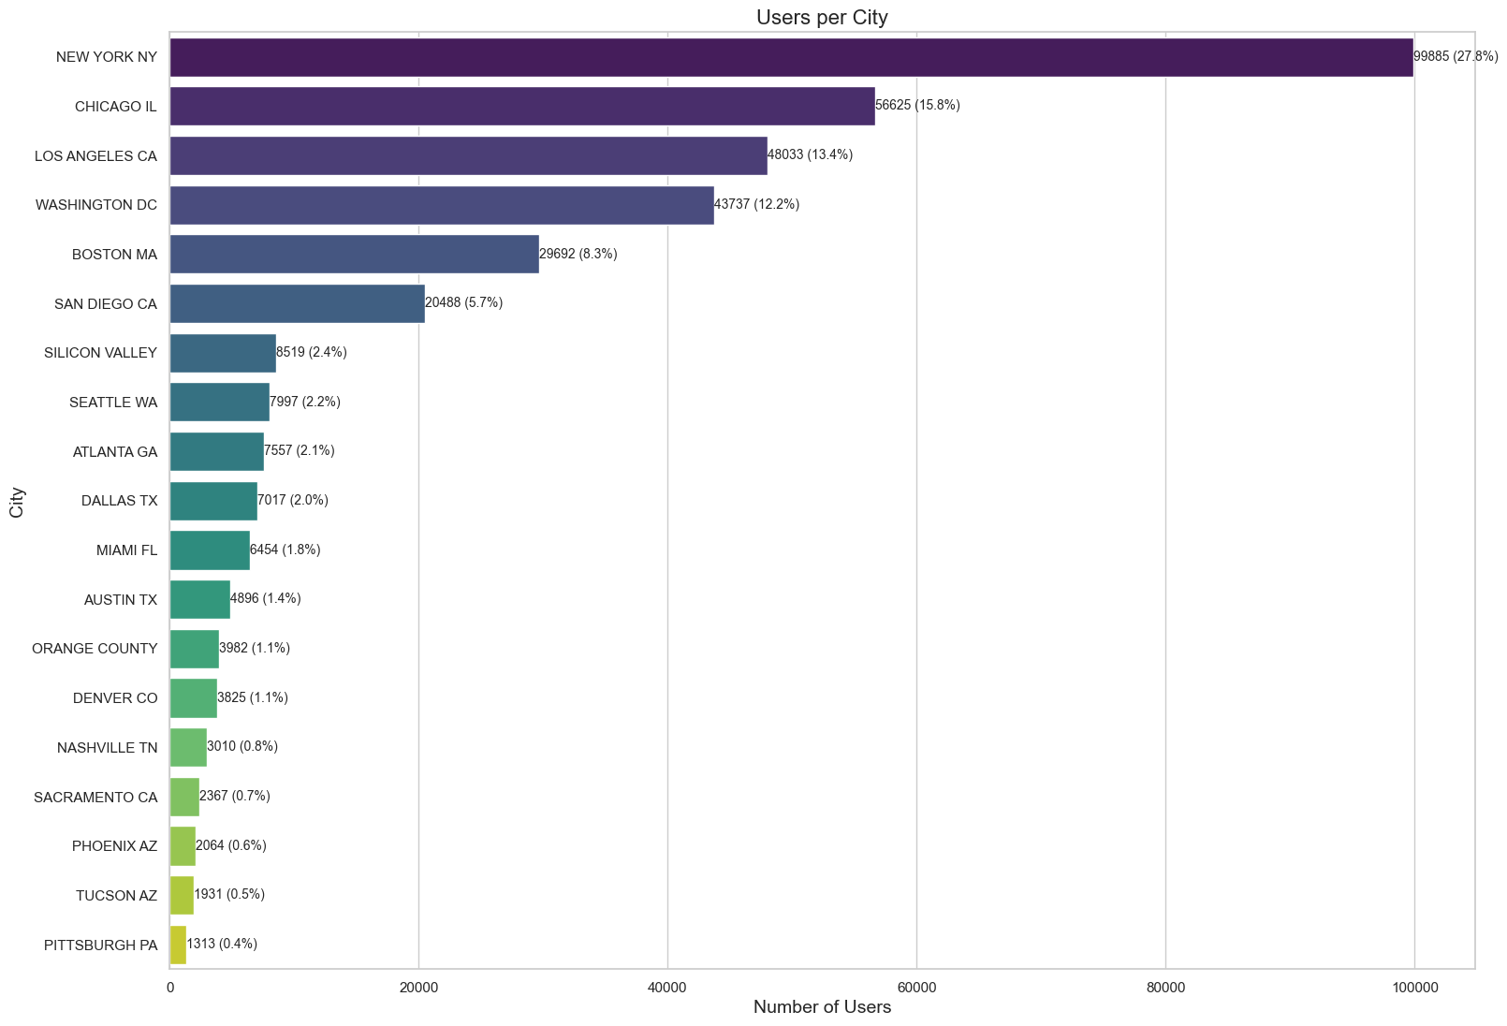
Users w.r.t Cities
New York City has the highest Cab users with 28% followed by Chicago with 16% and Los Angeles with 13%

Slide 15
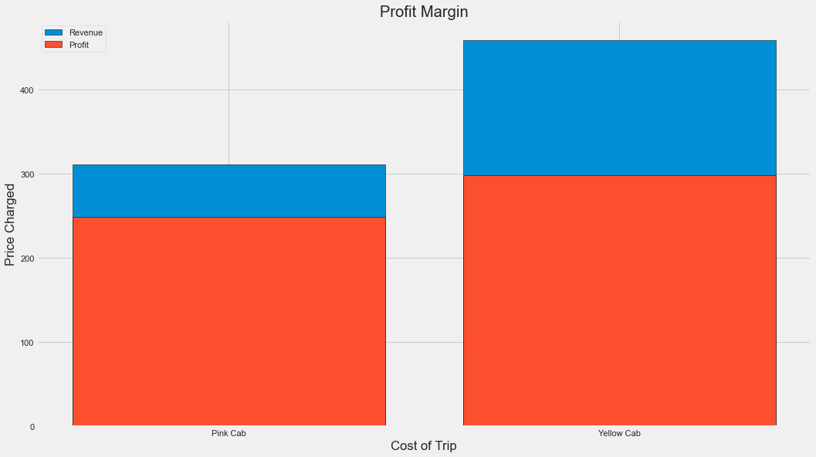
Profit Margin
The Yellow cab has a higher Profit Margin (Price Charged - Cost of Trip) compared to Pink cab

Slide 16
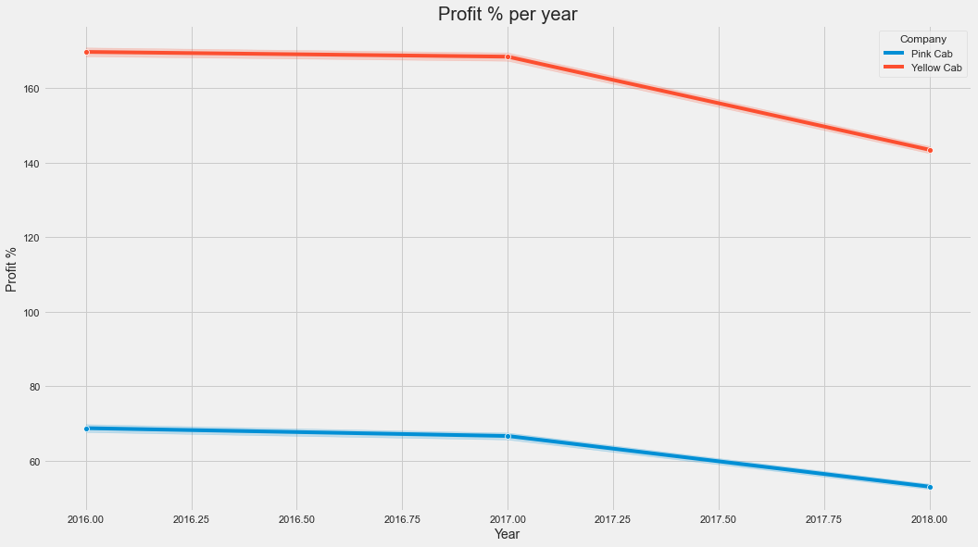
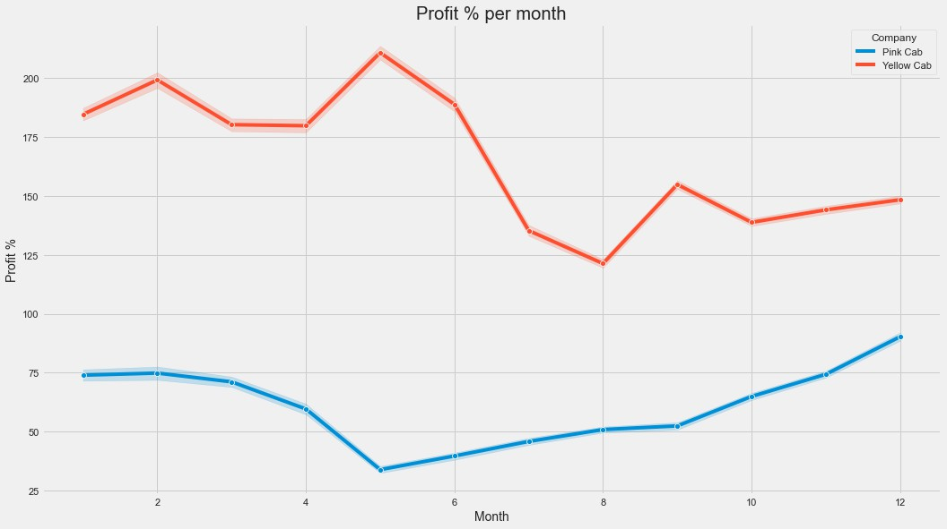
Profit Margin w.r.t Time
The profit margin decreased w.r.t year
The profit margin varies w.r.t month

Slide 17
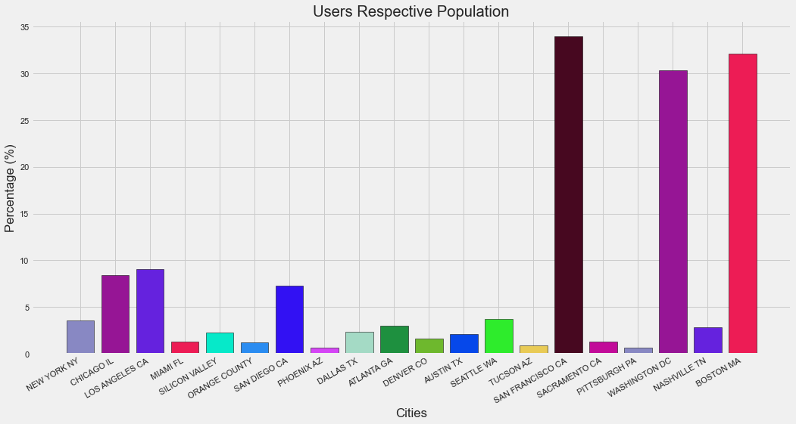
Users w.r.t Population
As we can see in the cities of San Francisco, Washington, and Boston more than 30% of the population use cab service

Slide 18
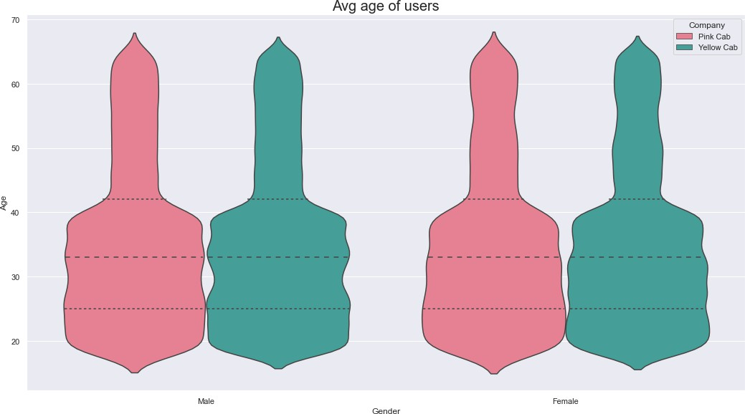
Average Age of Users
As we can see 35 Avg age of females and Male who use Cab service

Slide 19
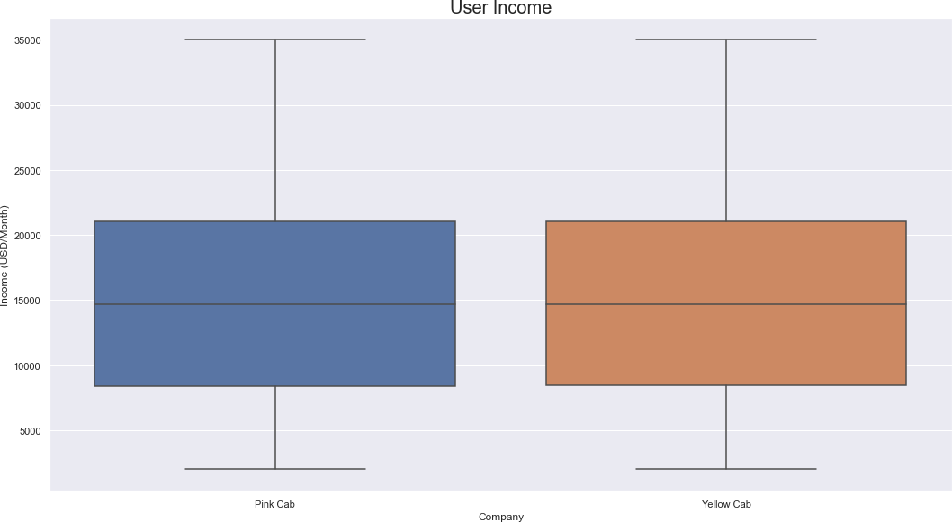
Average Income of Users
As we can see Avg income is around 15k$ who use cab service

Slide 20
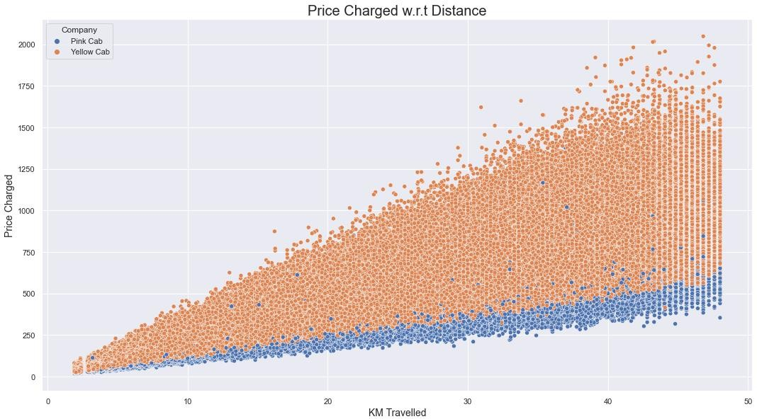
Price Charged w.r.t Distance
As we can see there is a linear relationship between KM traveled and Price Charged as we expected. However, Yellow Cab has high charges compared to Pink.

Slide 21
Hypothesis 1: Is there any difference in profit regarding Gender
Pink Cab Company
H0: There is no difference regarding Gender in both cab companies.
H1: There is a difference regarding Gender in both cab companies.
Yellow Cab Company
Conclusion
There is no difference regarding Gender in both cab companies

Slide 22
Pink Cab Company
Hypothesis 2: Is there any difference in Profit regarding Age
H0: There is no difference regarding Age in both cab companies.
H1: There is a difference in Age in both cab companies.
Yellow Cab Company
Conclusion
Looks like Yellow Cab company offers discounts for their customers who are older than 60 years old.

Slide 23
Pink Cab Company
Hypothesis 3: Is there any difference in Profit regarding Payment mode
H0: There is no difference regarding Payment Mode in both cab companies.
H1: There is a difference regarding Payment Mode in both cab companies.
Yellow Cab Company
Conclusion
There is no difference in payment mode for both cab companies

Slide 24

Conclusion
Yellow Cab Company is better than Pink Cab Company Because:
Profit Margin
More Users
More transactions per Year

Slide 25
Thank You

